Slide 1
Solar Power Generation
P526-G1
Predicting energy production using environmental factors
Group 1
Members: Kaushik Varma, Jovin Deris.E, Yashaswini.N, Tejal Mudaliar, Suraj Kumar, Goli Rakesh, Goutham J S

Slide 2
Agenda
Project & Dataset Overview
Exploratory Data Analysis
Machine Learning Model Selection
Model Performance & Results
Deployment Using Streamlit
Challenges Faced & Solutions
Key Factors Driving Customer Churn
Next Steps & Action Items
Conclusion

Slide 3
Project Overview
Objective:Predict solar power generation using environmental conditions.
Type: Regression project (continuous target).
Techniques Used: Machine Learning for Regression & Prediction.
Goal: Build a machine learning model to estimate power generated (in Joules) based on features like temperature, wind speed, sky cover, etc.

Slide 4
Dataset Overview
Source: Solar Power Generation
Total Records: 2920 rows
Features Overview (10):
distance_to_solar_noon (radians)
temperature (°C)
wind_direction (0–360°)
wind_speed (m/s)
sky_cover (0–4 scale)
visibility (km)
humidity (%)
average_wind_speed (m/s)
average_pressure (inHg)
power_generated (target, in Joules)

Slide 5
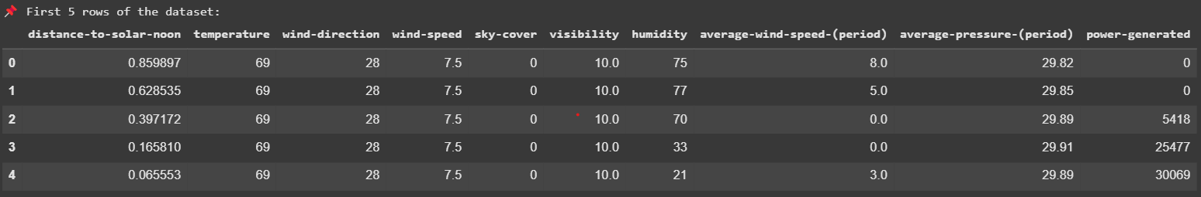
Dataset Overview

Slide 6
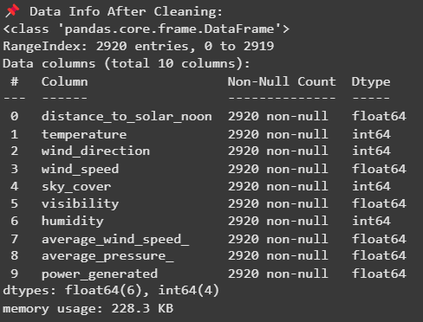
Dataset Overview

Slide 7
Exploratory Data Analysis (EDA)
Missing values: Identified and handled.
Outliers: Detected using boxplots.
Skewness: Handled for skewed variables using transformation if needed.
Correlation matrix: Revealed feature relationships.
Distributions: Plotted for all features to understand spread and detect anomalies.
Visualizations: Correlation Matrix, Pairplot, lineplot, Histogram.

Slide 8
Machine Learning Model Selection
Preprocessing:
Encoding categorical variables.
Feature scaling.
Train-Test split.
Models Evaluated:
XGBRegressor
Decision Tree Regressor
Random Forest Regressor
Gradient Boosting Regressor
Performance Metrics:
Mean Squared Error(MSE)
R2 Score.

Slide 9
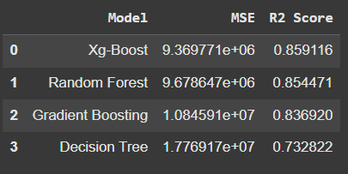
Model Performance & Results
Performance of Regression Models:

Slide 10

Model Performance & Results
Evaluation Metric Report for the XGBoost Model

Slide 11
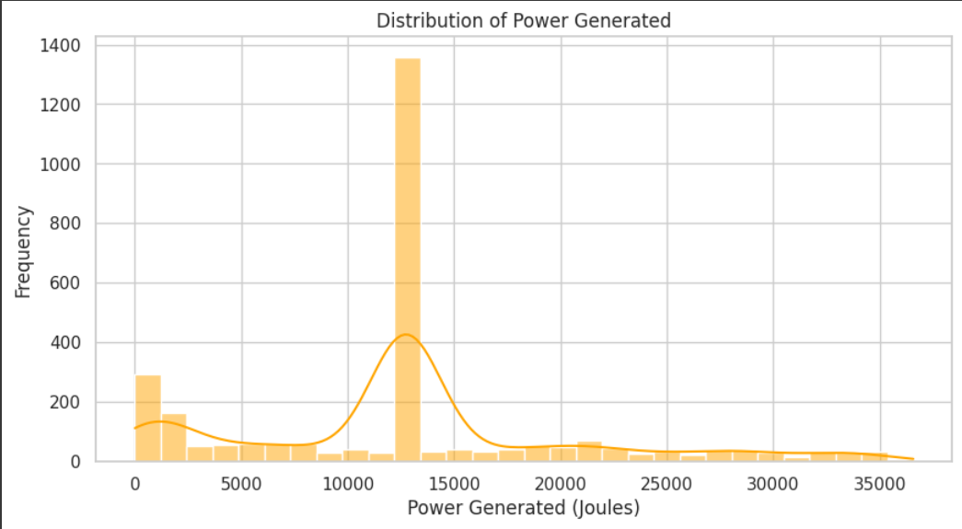
Visualizations
Histogram Plot
Most power values are centered around 13,000 Joules, indicating typical solar output during optimal conditions.
A smaller peak near 0 Joules suggests low or no sunlight (e.g., cloudy or night time).
The distribution is right-skewed, with a few high values.
This pattern helps understand solar output trends and guides model preprocessing like log transformation.

Slide 12
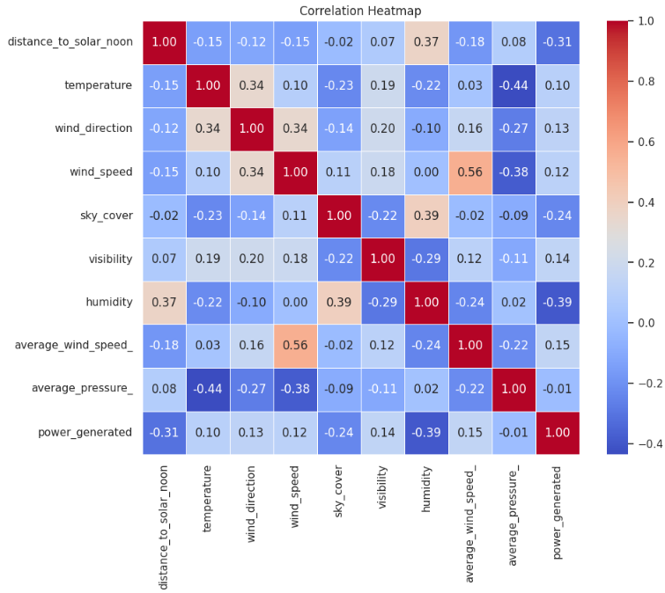
Visualizations
Correlation Heatmap
This correlation heatmap shows relationships between weather variables and power generated:
Power generated is:
Negatively correlated with humidity (-0.39) and distance_to_solar_noon (-0.31)
Slightly positively correlated with wind_speed (0.12) and average_wind_speed_ (0.15)
Wind_speed and average_wind_speed_ are strongly correlated (0.56)
Most other variables have weak or no correlation with power output.

Slide 13
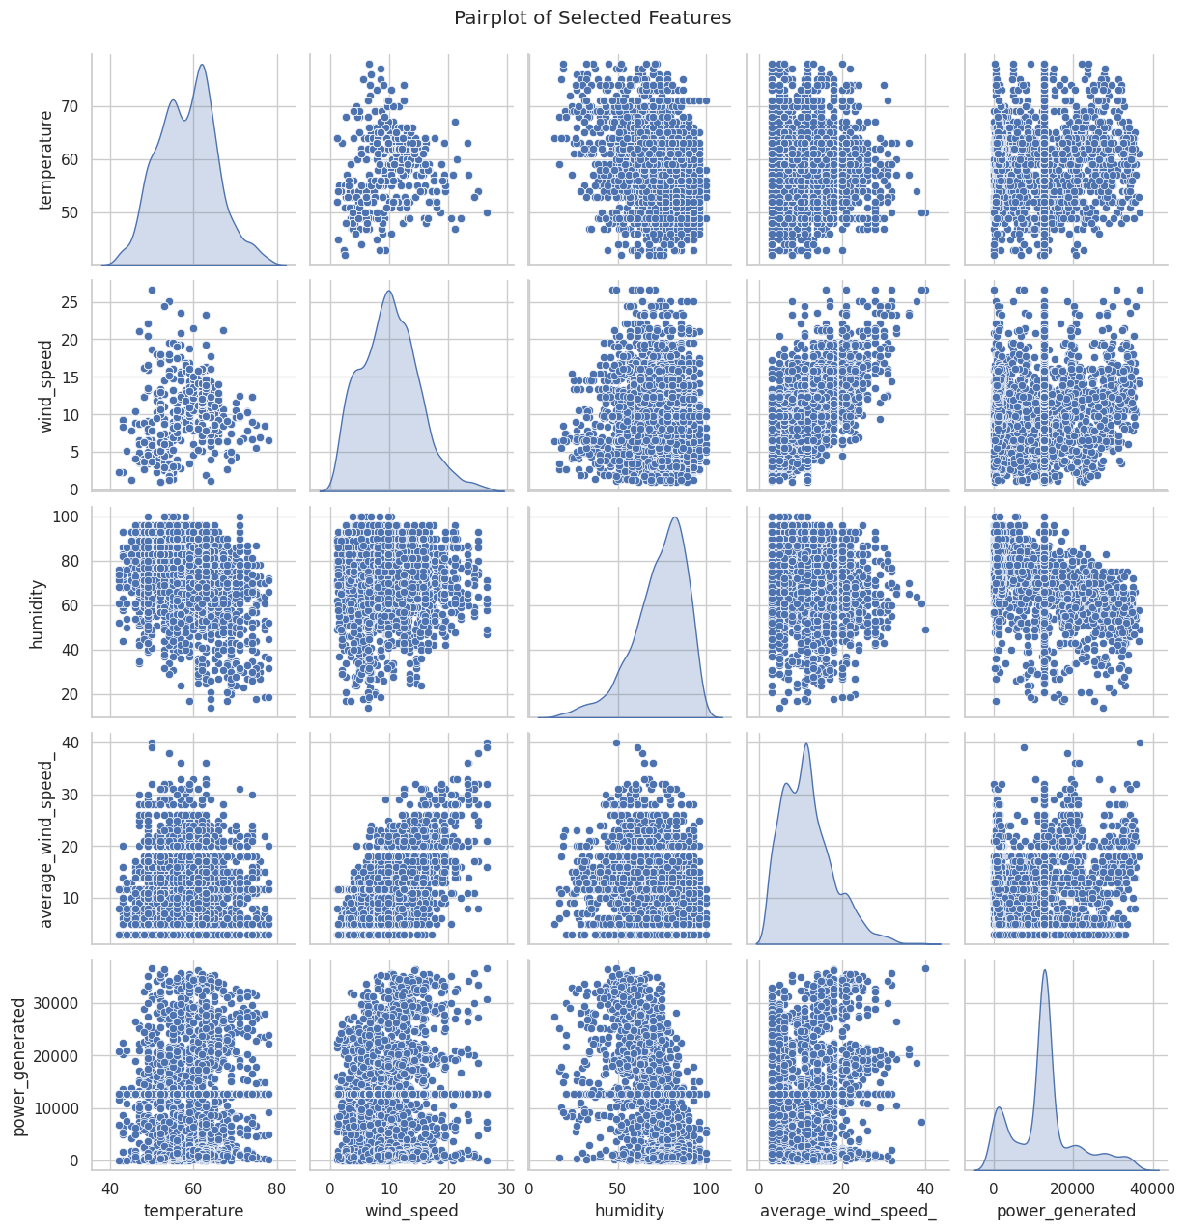
Visualizations
Pair Plot
This is a pairplot showing scatter plots and distributions for selected features
Diagonal: Shows individual feature distributions. For example, temperature and average_wind_speed_ are roughly normally distributed, while humidity is skewed.
Scatter plots: Show pairwise relationships:
power_generated vs humidity: Slight negative trend
power_generated vs average_wind_speed_ & wind_speed: Weak positive trend
Most other relationships are scattered, indicating weak or no clear correlation.

Slide 14
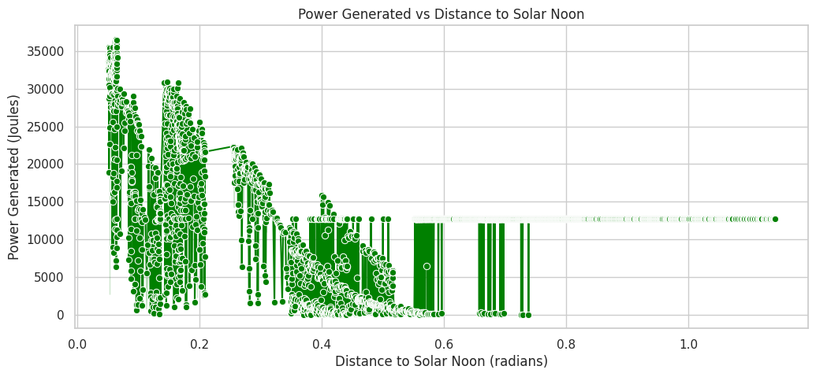
Visualizations
Line Plot
This scatter plot shows the relationship between Power Generated and Distance to Solar Noon.
As the distance from solar noon increases, power generated decreases.
Peak power is generated closer to solar noon (when the sun is highest in the sky).
This confirms a negative correlation, as also seen in the heatmap.

Slide 15
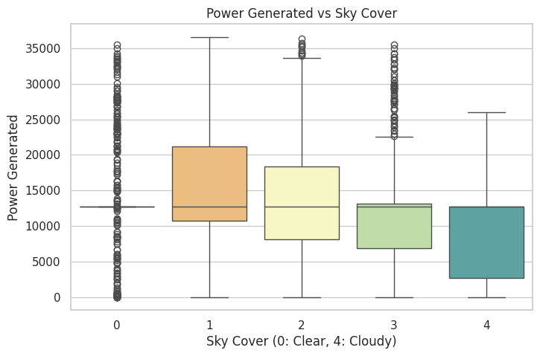
Visualizations
Box Plot
This boxplot shows the relationship between Sky Cover and Power Generated.
Sky Cover 0 (Clear) generally results in the highest power generation.
As sky cover increases (more clouds), power generation decreases.
There’s a negative impact of cloudiness on solar power generation.

Slide 16
Deployment Using Streamlit
Built an interactive app using Streamlit.
User inputs environmental parameters via sidebar.
App predicts power_generated in real-time.
App logic includes:
Input scaling using saved StandardScaler.
Prediction using pre-trained XGBoost model.
Display of predicted energy (log & original scale).

Slide 17
Screenshots of Streamlit Application

Slide 18
Screenshots of Streamlit Application

Slide 19
Challenges Faced & Solutions
Missing & invalid data → Cleaned, filled, or removed.
Feature skewness & scaling → Addressed via transformation and normalization.
Model generalization → Solved via model tuning and comparison.

Slide 20
Key Factors Driving Solar Power Output
Distance to solar noon
Temperature
Sky cover
Wind speed & direction
Humidity & visibility

Slide 21
Next Steps & Action Items
Improve model using hyperparameter tuning or ensemble stacking.
Add solar panel characteristics if available (e.g., efficiency, surface area).
Explore time-series-based forecasting for future generation.
Deploy fully online via Streamlit Cloud or another cloud provider.

Slide 22
Conclusion
Successfully built and deployed a predictive model for solar power generation.
XGBoost Regressor gave the most accurate and robust results.
Deployment using Streamlit offers a user-friendly interface.
The project demonstrates the importance of environmental factors in energy prediction and has real-world applications in sustainable energy planning.

